Slide 1




NEXT GEN EMPLOYABILITY PROGRAM
Creating a future-ready workforce
Team Members
College Name
Student Name : Hari Akshana A
Student ID : au960221243021
Arunachala College Of Engineering For Women

Slide 2

CAPSTONE PROJECT SHOWCASE
Project Title
Car Rentals Application with Django Framework
Abstract | Problem Statement | Project Overview | Proposed Solution | Technology Used | Modelling & Results | Conclusion

Slide 3
Abstract
Customers will be able to reserve their vehicles from anywhere Customers will be able to reserve their vehicles from anywhere in the world due to the Car Rental System. Consumers provide information to this application by filling in their personal information. When a consumer creates an Customers will be able to reserve their vehicles from anywhere in the world due to the Car Rental System. Consumers provide information to this application by filling in their personal information. When a consumer creates an account on the website, he or she can reserve a car. The proposed system is an online system that is fully integrated. It effectively and efficiently automates manual procedures. Customers are aided by this automated method, which allows them to fill in the specifics according to their needs. It contains information on the sort of car they want to hire as well as the location. The goal of this system is to create a website where customers can book their automobiles and request services from anywhere in the world.account on the website, he or she can reserve a car.
Source : www.researchgate.net

Slide 4
Problem Statement
Customers will be able to reserve their vehicles from anywhere in the world due to the Car Rental System. Consumers provide information to this application by filling in their personal information. When a consumer creates an account on the website, he or she can reserve a car. The proposed system is an online system that is fully integrated. It effectively and efficiently automates manual procedures. Customers are aided by this automated method, which allows them to fill in the specifics according to their needs. It contains information on the sort of car they want to hire as well as the location. The goal of this system is to create a website where customers can book their automobiles and request services from anywhere in the world.
Source : www.researchgate.net

Slide 5
Project Overview
This project proposes a car rental system designed to simplify the rental process for both customers and car rental agencies. The core focus is on creating a user-friendly experience through:
Online booking and management platform
Real-time availability.
Integrated payment processing
Flexible rental options
Personalized user accounts
Streamlined administrative tools
Benefits:
Improved customer experience
Increased efficiency for rental agencies
Enhanced customer satisfaction
This project aims to revolutionize the car rental experience by prioritizing user-friendliness and streamlining the process for both customers and agencies.
Source : www.researchgate.net

Slide 6
Proposed Solution
.
This system tackles the pain points of traditional car rentals. Our user-centric platform empowers customers to browse vehicles, compare rates, and book their perfect ride instantly – all online. Real-time availability keeps the process smooth, while secure integrated payments ensure a seamless experience. We offer flexible rental options, from budget-friendly compacts to spacious SUVs, with customizable add-ons for ultimate convenience. Rental agencies gain powerful tools to manage their fleet, bookings, and customer information – all in one centralized platform. Customers enjoy a stress-free car rental experience, while agencies achieve operational efficiency and increased customer satisfaction.
Source :www.researchgate.net

Slide 7
Key Components
User-Friendly Interface: We will develop an intuitive and visually appealing interface accessible via web browsers and mobile devices. This interface will enable customers to easily search for available vehicles, view detailed information, and make reservations with minimal effort.
Real-Time Availability: Implementing real-time availability tracking, customers will have access to up-to-date information on vehicle availability, ensuring accurate booking and minimizing the risk of overbooking.
Seamless Booking Process: Our system will automate the booking process, allowing customers to complete reservations quickly and securely. Digital contracts and electronic signatures will streamline paperwork, reducing the time and effort required for both customers and providers.
Transparent Pricing: Clear and transparent pricing structures will be implemented, displaying all costs upfront to eliminate confusion and surprise fees. Customers will have a complete understanding of the rental costs, enhancing trust and satisfaction.
Efficient Fleet Management: Rental providers will benefit from advanced fleet management tools, including features for tracking vehicle utilization, scheduling maintenance, and optimizing fleet distribution. This will maximize the utilization of resources and ensure the availability of well-maintained vehicles.
Secure Transactions: We will integrate robust security measures to protect user data and financial information. Secure payment gateways and encryption protocols will safeguard transactions, providing peace of mind to both customers and providers.
Source :www.researchgate.net

Slide 8
Function and Non Functional Requirements
The functional requirements discovered are as follows:
1) Customer registration – New users should be able to register online and print membership cards.
2) Car reservation online – Customers should be able to utilise the system to book and reserve automobiles online.
3) Automatic database update once a reservation is made or a new customer is registered – The system should be able to update the database without any further effort from the administrator whenever a new reservation or registration is made.
The non functional requirements are as follows:
1) Security
2) Performance and Response Time
3) Error Handling
4) Availability
5) Ease of Use
Source : www.researchgate.net

Slide 9


Technology Used
Front-end
Back-end
Source :

Slide 10
Modelling & Results
System Design:
Analyze requirements.
Create detailed system design.
Specify UI, database, backend logic.
Expected Result: System design document.
Development:
Implement system using web technologies.
Frontend and backend development.
Follow best practices.
Expected Result: Fully functional prototype.
Testing:
Rigorous testing for reliability, performance, usability.
Functional, usability, performance, security testing.
Expected Result: Thoroughly tested system.
Deployment:
Deploy to production environment.
Configure infrastructure, deploy code.
Monitor and address issues.
Expected Result: Live system ready for use.
Source : www.chatgpt.com

Slide 11
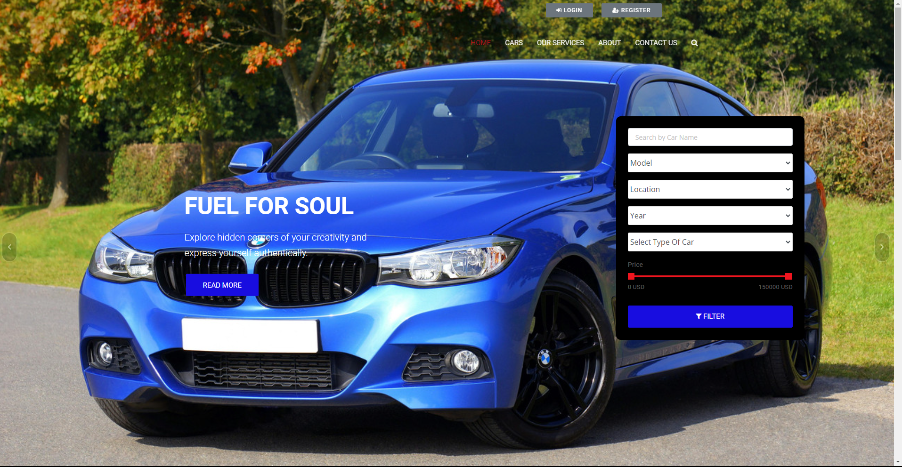
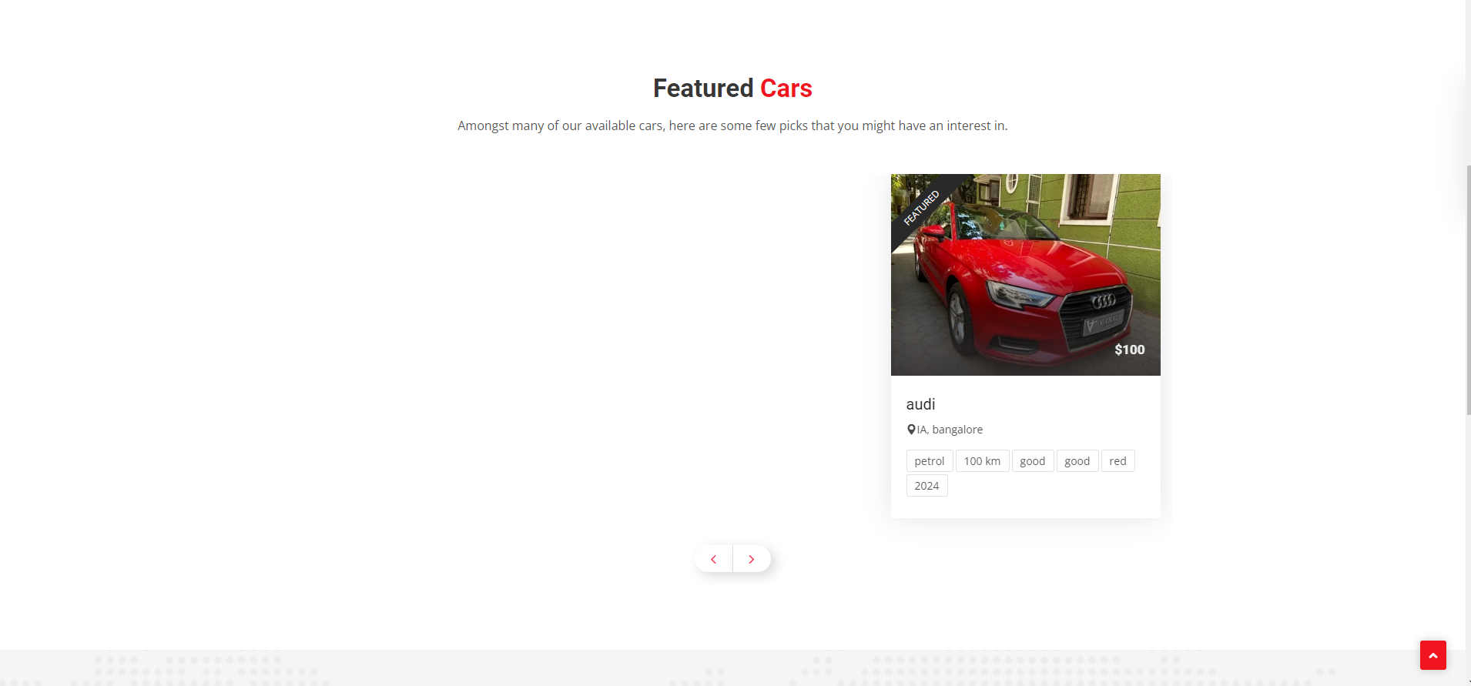
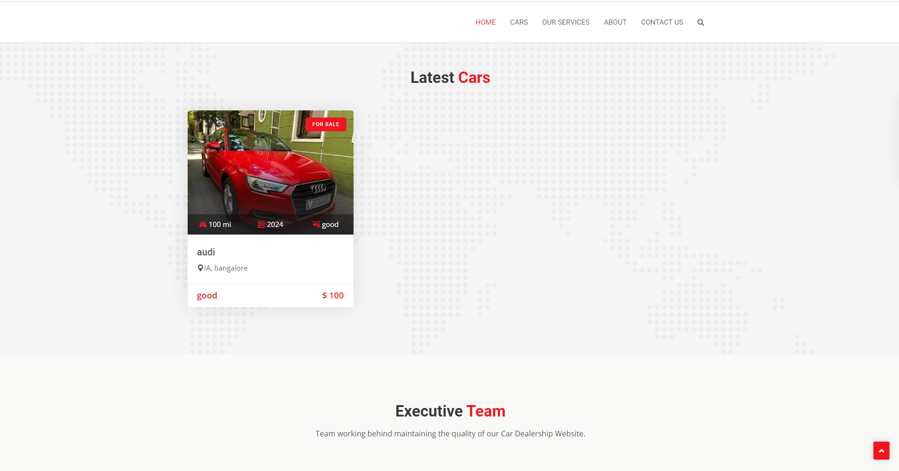
Homepage

Slide 12
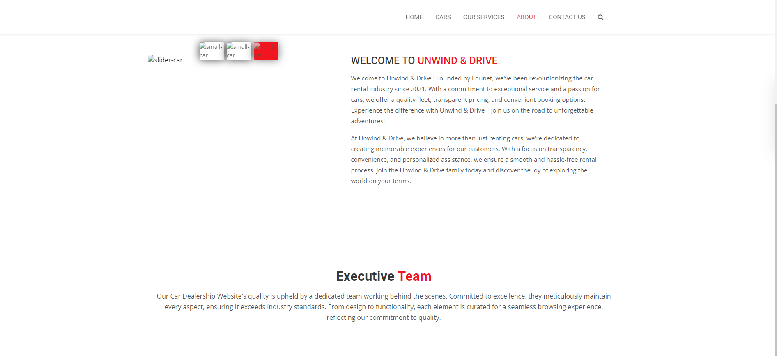
About-Us-Page

Slide 13
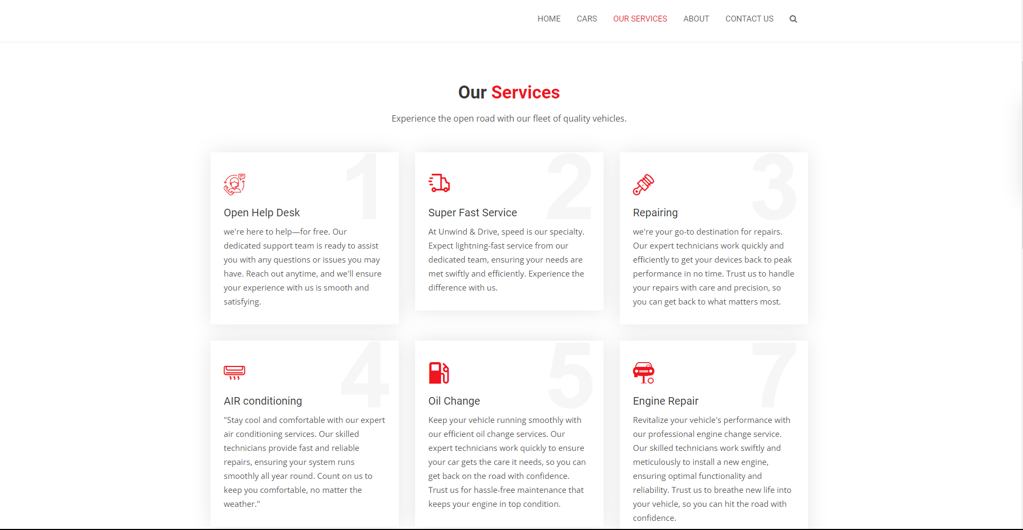

Service-Page

Slide 14
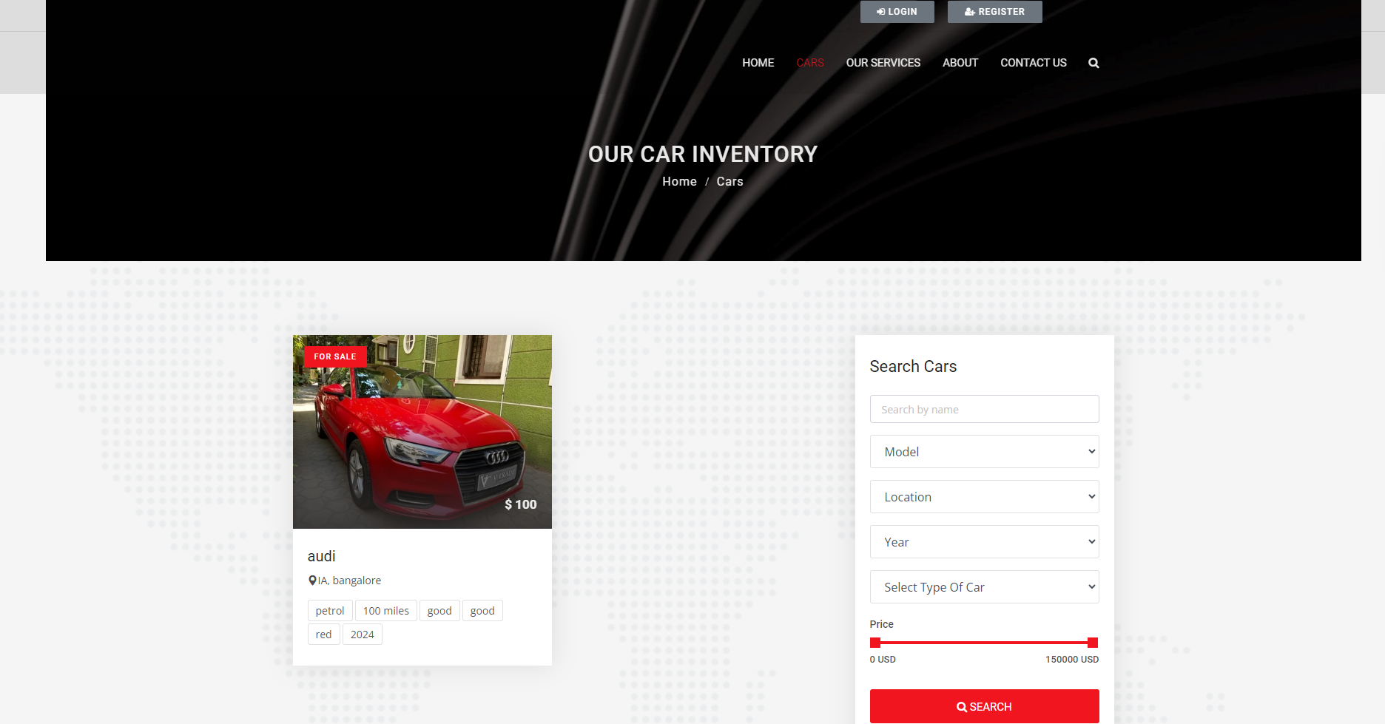
Departments-Page

Slide 15
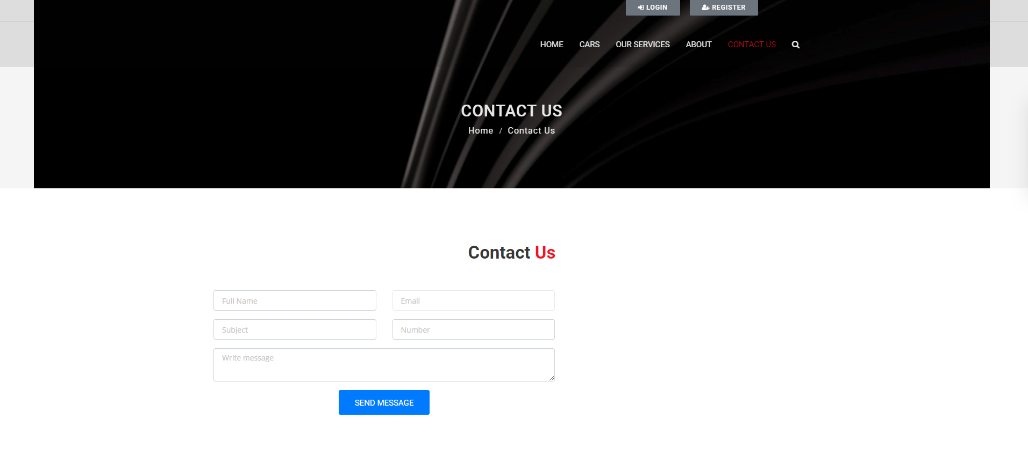
Blog-Page

Slide 16
Future Enhancements:
Building on the core user-friendly features, here's a glimpse into potential future enhancements for our car rental system:
AI-powered Recommendations: Utilize artificial intelligence to recommend vehicles based on customer preferences, trip details, and past rental history, creating a personalized and efficient experience.
Keyless Entry with Smartphone Integration: Leverage smartphone technology for a seamless rental experience. Customers could unlock and lock vehicles directly using their phones, eliminating the need for physical keys.
Advanced Vehicle Telematics: Integrate real-time vehicle data for features like location tracking, fuel level monitoring, and predictive maintenance. This improves security, allows for optimized routing suggestions, and streamlines maintenance for rental agencies.
Self-Service Options: Implement self-service kiosks at pick-up and drop-off locations to reduce wait times and offer an even more convenient car rental experience.
Partnership with Ride-Sharing Services: Explore partnerships with ride-sharing platforms to offer customers a wider range of mobility options, catering to diverse travel needs.

Slide 17
Conclusion
In conclusion, the development of a modernized car rental system represents a significant step forward in meeting the evolving needs of customers and providers in the transportation industry. By leveraging advanced web-based technologies and innovative features, our proposed solution aims to streamline the rental process, enhance transparency and efficiency, and deliver a seamless experience for all stakeholders involved.
Through rigorous system design, development, testing, and deployment, we have laid the foundation for a robust and reliable car rental platform. Moving forward, we envision further enhancements and expansions to meet the demands of future mobility trends, including personalized experiences, sustainable practices, and integration with emerging technologies.
Ultimately, our goal is to set new standards in the car rental industry, providing a model for innovation, efficiency, and customer satisfaction. We are excited about the future possibilities and remain committed to delivering a superior rental experience that exceeds expectations and drives positive change in the transportation landscape.
Source : www.chaptgpt.com

Slide 18
Thank You!
Notes:
Thank You !!

